Slide 1
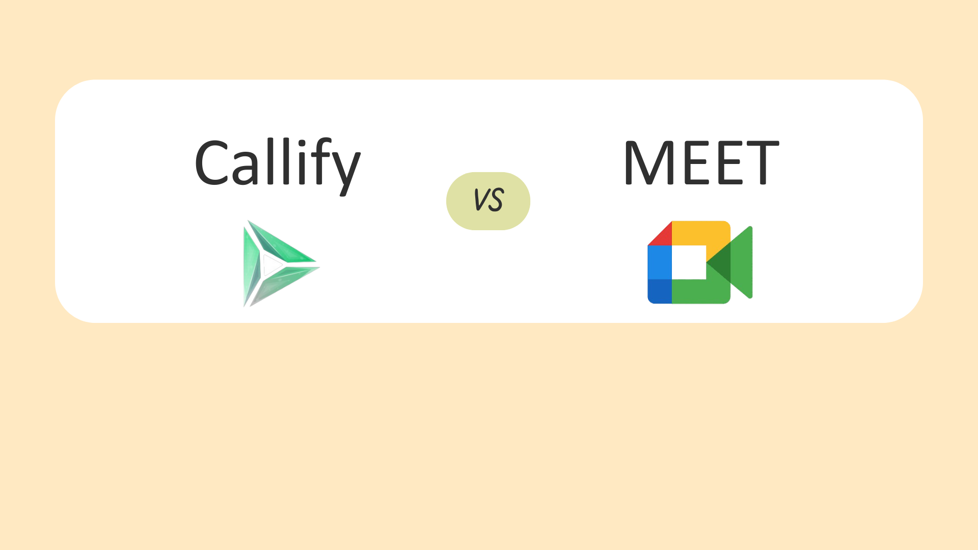
Why Callify is Better compare TO Google Meet

Slide 2
Disadvantage of Google Meet

Slide 3
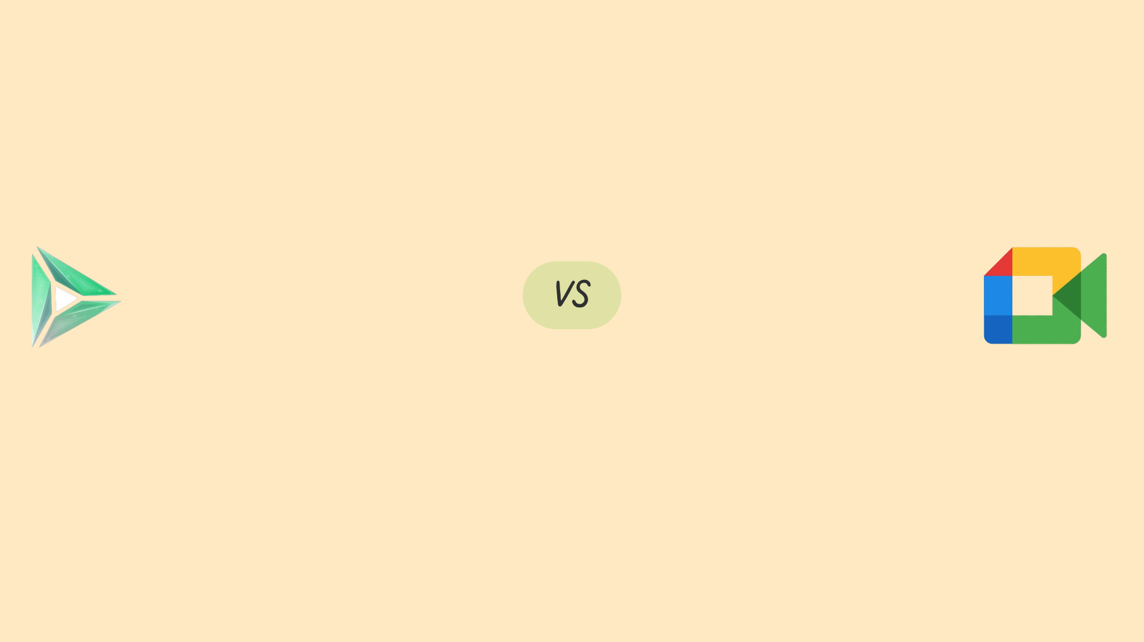
Technical Issues
Connectivity problems: Poor internet connectivity can cause issues.
Audio and video delays: Delays can disrupt meetings.
Software glitches: Bugs and glitches can cause functionality issues.
Compatibility issues: Google Meet may not work seamlessly with all devices or browsers.

Slide 4
Limitations
Limited free version features: The free version has time limits and limited features.
Restricted recording capabilities: Recording meetings requires a Google Workspace account.
Limited virtual event capabilities: Google Meet is primarily designed for meetings, not large events.

Slide 5
Security and Privacy Concerns
Data collection: Google's data collection practices have raised concerns.
Encryption issues: Google Meet's end-to-end encryption has been questioned.
Vulnerabilities: Google Meet has experienced security vulnerabilities.
Compliance issues: Google Meet's compliance with regulations like HIPAA and GDPR has been questioned.

Slide 6
Cost and Pricing
1. Costly for large teams: Enterprise plans can be expensive.
Limited features in basic plans: Paid plans are required for advanced features.
Additional costs for add-ons: Some features, like cloud storage, incur extra costs.

